Slide 1


Synthetic Forward FX Replication
& Collateralized Discount Factors
Nicholas Burgess

Slide 2

Synthetic Forward FX – Interest Rate Parity
Interest Rate Parity (IRP)
IRP states that the interest rate differential between two countries equals the forward exchange rate premium or discount relative to the spot rate and ensures no arbitrage opportunities as follows¹,
The lower interest rate currency usually trades at a forward premium relative to the higher rate currency
Rearranging (1) gives,
Rewriting in terms of Discount Factors, P(0,t) gives,
$$\frac{Fwd FX\left({USD}/{BRL}\right)}{Spot FX({USD}/{BRL})}=\left(\frac{1+r^{USD}t}{1+r^{BRL}t}\right) (1)$$
$$Fwd FX\left({USD}/{BRL}\right)=Spot FX\left({USD}/{BRL}\right)\left(\frac{1+r^{USD}t}{1+r^{BRL}t}\right) (2)$$
$$Fwd FX\left({USD}/{BRL}\right)=Spot FX\left({USD}/{BRL}\right)\left(\frac{{P\left(0,t\right)}^{BRL}}{{P\left(0,t\right)}^{USD}}\right) (3)$$
¹ For Forward FX < 1-year simple compounding is used and thereafter annual compounding.

Slide 3
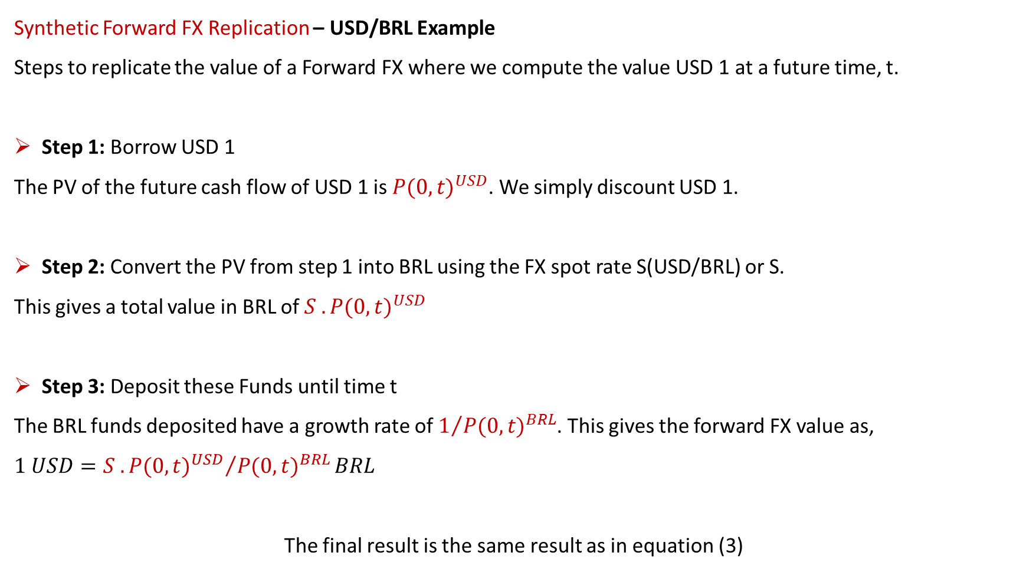
Synthetic Forward FX – Interest Rate Parity
Synthetic Forward FX Replication – USD/BRL Example
Steps to replicate the value of a Forward FX where we compute the value USD 1 at a future time, t.
Step 1: Borrow USD 1
The PV of the future cash flow of USD 1 is ${P(0,t)}^{USD}$. We simply discount USD 1.
Step 2: Convert the PV from step 1 into BRL using the FX spot rate S(USD/BRL) or S.
This gives a total value in BRL of ${S . P(0,t)}^{USD}$
Step 3: Deposit these Funds until time t
The BRL funds deposited have a growth rate of $1/{{P(0,t)}^{BRL}}$. This gives the forward FX value as,
$$1 USD={{S . P(0,t)}^{USD}}/{{P(0,t)}^{BRL}}BRL$$
The final result is the same result as in equation (3)

Slide 4
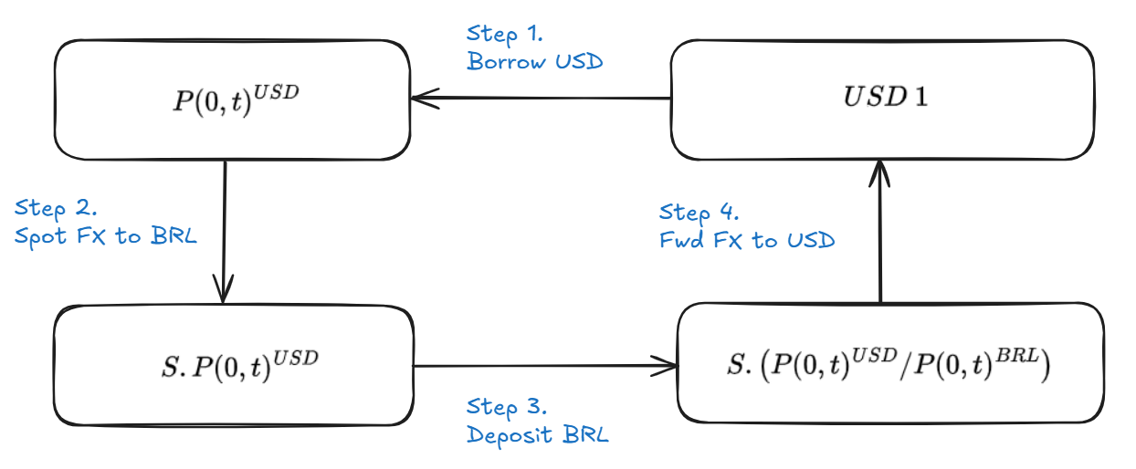
Synthetic Forward FX – Interest Rate Parity
Synthetic Forward FX Replication - USD/BRL Illustration
$$Fwd FX\left({USD}/{BRL}\right)=Spot FX\left({USD}/{BRL}\right)\left(\frac{{P\left(0,t\right)}^{BRL}}{{P\left(0,t\right)}^{USD}}\right)$$

Slide 5
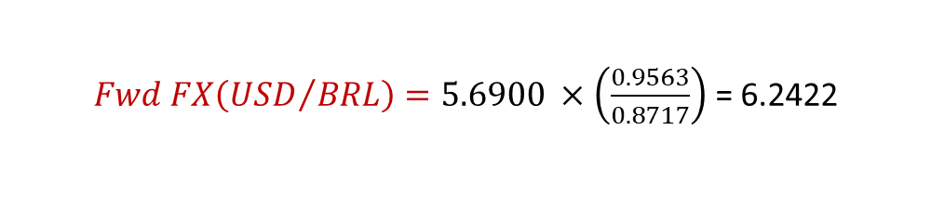
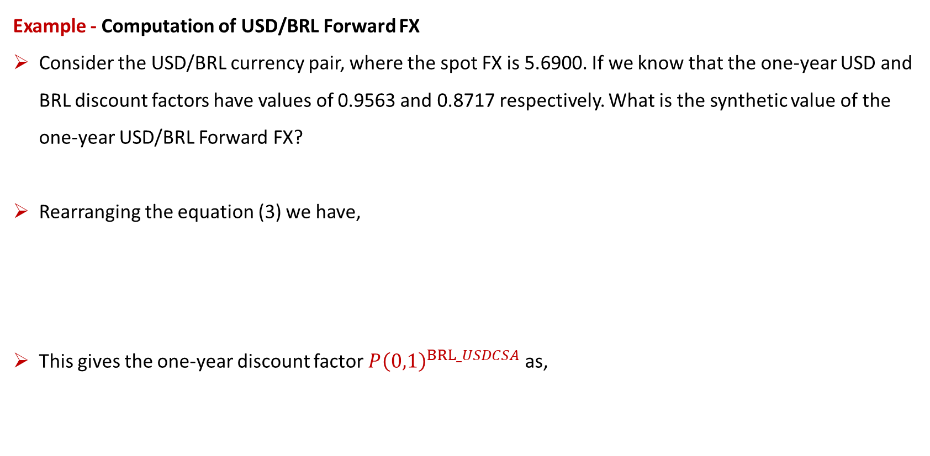
Synthetic Forward FX – Interest Rate Parity
Example - Computation of USD/BRL Forward FX
Consider the USD/BRL currency pair, where the spot FX is 5.6900. If we know that the one-year USD and BRL discount factors have values of 0.9563 and 0.8717 respectively. What is the synthetic value of the one-year USD/BRL Forward FX?
Rearranging the equation (3) we have,
This gives the one-year discount factor ${P\left(0,1\right)}^{BRL_USDCSA}$ as,
$$Fwd FX\left({USD}/{BRL}\right)=Spot FX\left({USD}/{BRL}\right)\left(\frac{{P\left(0,1\right)}^{BRL}}{{P\left(0,1\right)}^{USD}}\right) (3)$$
$Fwd FX\left({USD}/{BRL}\right)=5.6900 ×\left(\frac{0.9563}{0.8717}\right)$ = 6.2422

Slide 6
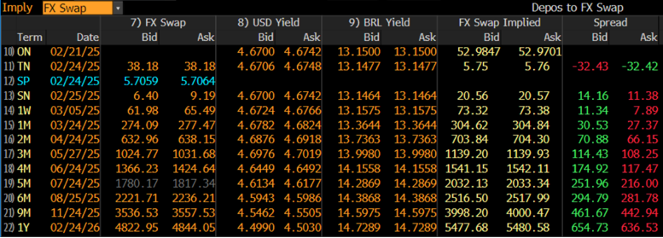
Synthetic Forward FX – Interest Rate Parity
Bloomberg FX Interest Rate Arbitrage - Bloomberg FXFA <GO>
Implying FX forwards can identify potential arbitrage opportunities.
Market forward FX rates usually do not match the synthetic (or implied) FX forward rates
Similarly, we can imply domestic and foreign interest rates or yields
Note: Outright Forward FX = Spot FX + (Forward Points * Pip Size), where pip size is often 10,000

Slide 7
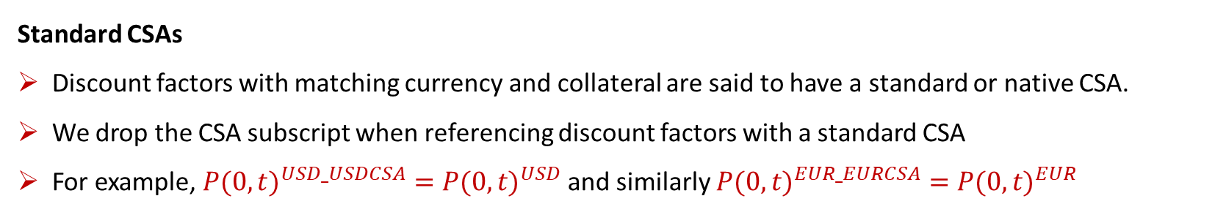
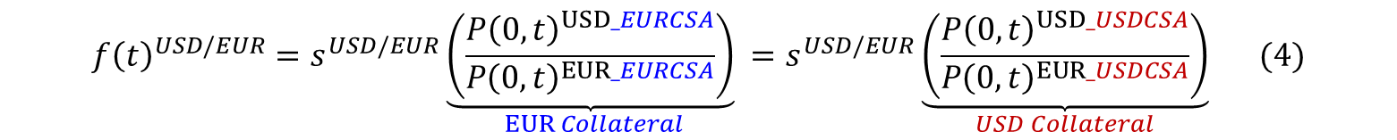
Synthetic Forward FX – FX Forward Invariance
FX Forward Invariance
Derived from Xccy Swaps where we have collateral posted in a single currency
FX Forward Invariance assumes forward FX is constant for any given collateral posted or CSA
Similar to Interest Rate Parity, however discount factors are collateralized in a single common currency
Using USD/EUR as an example the FX Forward Invariance formula looks as follows:
$$f{\left(t\right)}^{USD/EUR}=s^{USD/EUR}\underset{EUR Collateral}{\underbrace{\left(\frac{{P\left(0,t\right)}^{USD_EURCSA}}{{P\left(0,t\right)}^{EUR_EURCSA}}\right)}}=s^{USD/EUR}\underset{USD Collateral}{\underbrace{\left(\frac{{P\left(0,t\right)}^{USD_USDCSA}}{{P\left(0,t\right)}^{EUR_USDCSA}}\right)}} (4)$$
Standard CSAs
Discount factors with matching currency and collateral are said to have a standard or native CSA.
We drop the CSA subscript when referencing discount factors with a standard CSA
For example, ${P(0,t)}^{USD_USDCSA}={P(0,t)}^{USD}$ and similarly ${P(0,t)}^{EUR_EURCSA}={P(0,t)}^{EUR}$

Slide 8
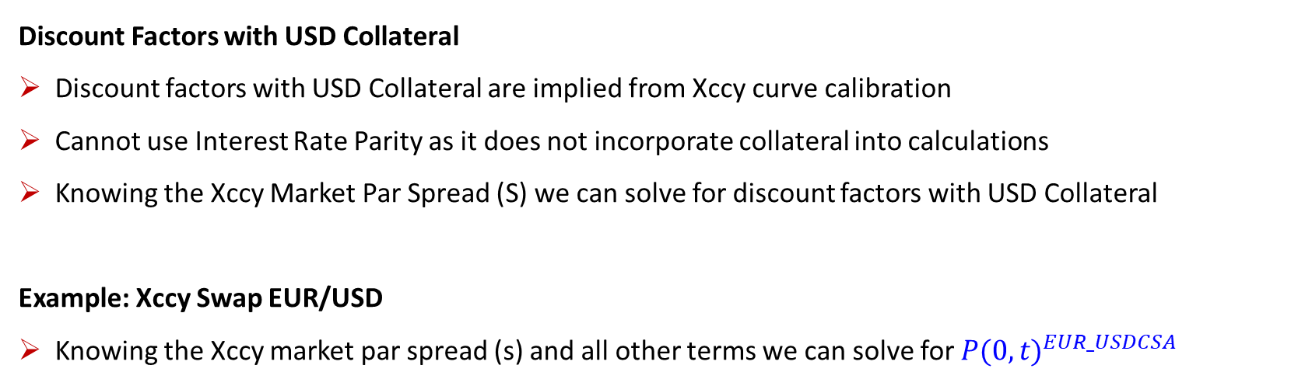
FX Forward Invariance – Discount Factors with USD Collateral
Discount Factors with USD Collateral
Discount factors with USD Collateral are implied from Xccy curve calibration
Cannot use Interest Rate Parity as it does not incorporate collateral into calculations
Knowing the Xccy Market Par Spread (S) we can solve for discount factors with USD Collateral
Example: Xccy Swap EUR/USD
Knowing the Xccy market par spread (s) and all other terms we can solve for ${P(0,t)}^{EUR_USDCSA}$
$$\underset{USD Trade Leg}{\underbrace{∑N.(SOFR Rate).τ.{P(0,t)}^{USD}}}= \underset{EUR Trade Leg}{\underbrace{∑N.(ESTR+s).τ.{P(0,t)}^{EUR_USDCSA}}}$$

Slide 9
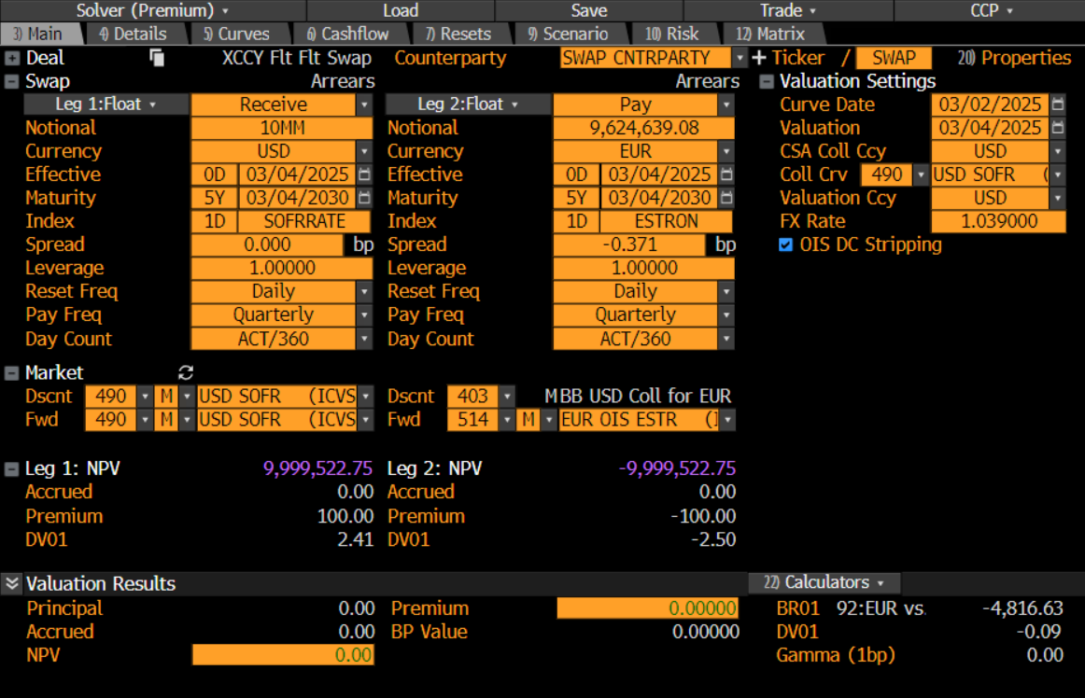
FX Forward Invariance – Discount Factors with USD Collateral
Bloomberg Illustration: Xccy Swap EUR/USD 5Y
Knowing the Xccy Market Par Spread (s) we can solve for discount factors with USD Collateral
$$\underset{USD Trade Leg}{\underbrace{∑N.(SOFR Rate).τ.{P(0,t)}^{USD}}}= \underset{EUR Trade Leg}{\underbrace{∑N.(ESTR+s).τ.{P(0,t)}^{EUR_USDCSA}}}$$

Slide 10
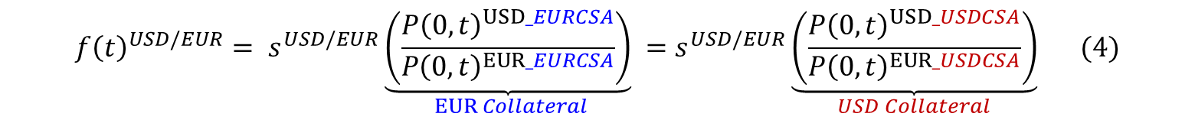
FX Forward Invariance – Discount Factors with Non-USD Collateral
Discount Factors with Non-USD Collateral
These can be derived from the FX Forward Invariance formula from (4)
First, we must first calibrate a Xccy Curve(s) to generate discount factors with USD CSAs
Second, compute non-USD discount factors (DFs) using (4)
Computation from Xccy Swaps or FX Forwards
We can imply non-USD collateral DFs from USD collateral DFs from Xccy Swaps using the RHS of (4)
Alternatively, we can imply non-USD collateral DFs from FX rates using the LHS of (4)
The results will be different and potential arbitrage opportunities may exist.
$$f{\left(t\right)}^{USD/EUR}= s^{USD/EUR}\underset{EUR Collateral}{\underbrace{\left(\frac{{P\left(0,t\right)}^{USD_EURCSA}}{{P\left(0,t\right)}^{EUR_EURCSA}}\right)}}=s^{USD/EUR}\underset{USD Collateral}{\underbrace{\left(\frac{{P\left(0,t\right)}^{USD_USDCSA}}{{P\left(0,t\right)}^{EUR_USDCSA}}\right)}} (4)$$

Slide 11


FX Forward Invariance – Discount Factors with Non-USD Collateral
Using Xccy Swaps for Discount Factors with Non-USD Collateral
We use the RHS of (4) if we want to imply discount factors with Non-USD collateral from Xccy Swaps
Note spot FX terms cancel and using standard CSA notation we have,
Rearranging gives,
$$f{\left(t\right)}^{USD/BRL}=\underset{RHS}{\underbrace{s^{USD/BRL}\left(\frac{{P\left(0,t\right)}^{USD_EURCSA}}{{P\left(0,t\right)}^{EUR_EURCSA}}\right)= s^{USD/BRL}\left(\frac{{P\left(0,t\right)}^{USD_USDCSA}}{{P\left(0,t\right)}^{EUR_USDCSA}}\right)}}$$
$$\left(\frac{{P\left(0,t\right)}^{USD_EURCSA}}{{P\left(0,t\right)}^{EUR}}\right)=\left(\frac{{P\left(0,t\right)}^{USD}}{{P\left(0,t\right)}^{EUR_USDCSA}}\right)$$
$${P\left(0,t\right)}^{USD_EURCSA}= \left(\frac{{P\left(0,t\right)}^{USD}{.P\left(0,t\right)}^{EUR}}{\underset{From Xccy Swaps}{\underbrace{{P\left(0,t\right)}^{EUR_USDCSA}}}}\right)$$

Slide 12

FX Forward Invariance – Discount Factors with Non-USD Collateral
Using FX Forwards for Discount Factors with Non-USD Collateral
We use the LHS of (4) if we want to imply discount factors with Non-USD collateral from FX Forwards
This is similar to Interest Rate Parity (IRP), except that discount factor terms need to be collateralized, in this case with EUR CSA collateral as follows,
Rearranging and noting that EUR_EURCSA is a standard CSA we have,
$$\underset{LHS}{\underbrace{f{\left(t\right)}^{USD/EUR}=s^{USD/EUR}\left(\frac{{P\left(0,t\right)}^{USD_EURCSA}}{{P\left(0,t\right)}^{EUR_EURCSA}}\right)}}=s^{USD/EUR}\left(\frac{{P\left(0,t\right)}^{USD_USDCSA}}{{P\left(0,t\right)}^{EUR_USDCSA}}\right)$$
$$f{\left(t\right)}^{USD/EUR}= s^{USD/EUR}\left(\frac{{P\left(0,t\right)}^{USD_EURCSA}}{{P\left(0,t\right)}^{EUR_EURCSA}}\right)$$
$${P\left(0,t\right)}^{USD_EURCSA}={P\left(0,t\right)}^{EUR_EURCSA} \left(\frac{f{\left(t\right)}^{USD/BRL}}{s^{USD/BRL}}\right)$$

Slide 13
FX Forward Invariance – Yield Curve Dependencies
Yield Curve Dependencies
Discount Factors with Collateral have yield curve dependencies
We must build yield curves in the correct order, outlined below
Yield Curve Calibration Order for Collateralized Discount Factors
Firstly, calibrate regular Swap Curves for Discount Factors with a Standard CSA
Secondly, calibrate Xccy Curves for Discount Factors with a USD CSA
Thirdly, use the FX Forward Invariance Formula for Discount Factors with a Non-USD CSA
Interest Rate Forwards and Discount Factors
Forward Rates do not require collateral adjustments
Only Discount Factors are adjusted for collateral

Slide 14
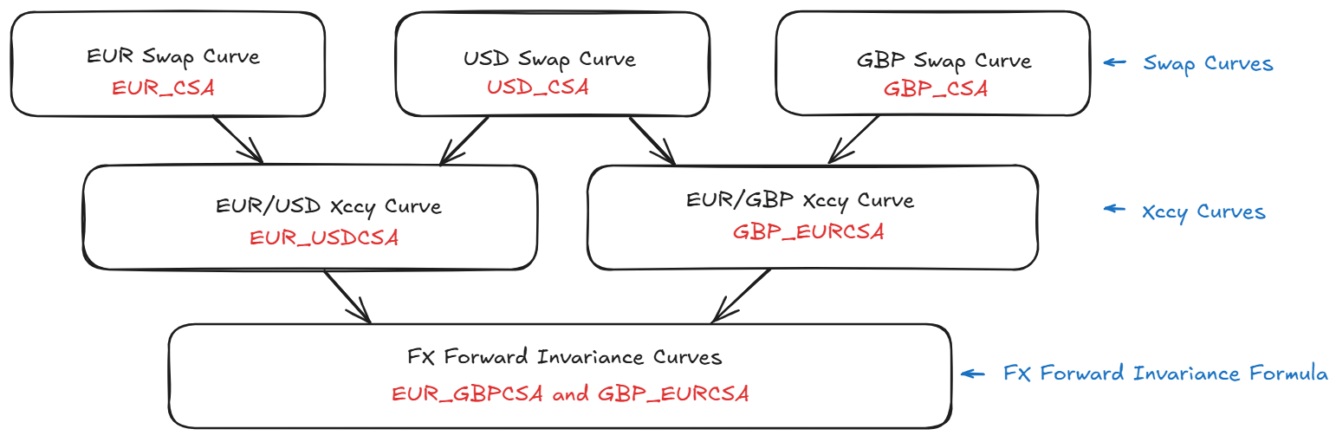
FX Forward Invariance – Yield Curve Dependencies
Illustration: Yield Curve Dependencies
We illustrate the yield curve dependencies below collateralized discount factor calculations.
Firstly, compute Standard CSAs, then USD CSAs then Non-USD CSAs as shown below.

Slide 15
Contact
Have questions or want further info?
LinkedIn: www.linkedin.com/in/nburgessx

